Slide 1





PRESENTATION 2026
Faculty Name
Faculty Email
Ms.Karthikeyani V
karthikaviswanath36@gmail.com
Mentor Name
Ms,Uma Maheswari R

Slide 2

Outline
Abstract of the Project
Problem Statement
Proposed Solution
System Architecture
Live Demo of the Project
Embedded Video of Project
Conclusion
Future Scope

Slide 3
Abstract
Student feedback plays a crucial role in evaluating teaching effectiveness and improving the overall quality of education. However, traditional feedback systems primarily rely on numerical ratings, which often fail to capture deeper insights and qualitative perspectives. To address this limitation, this project integrates Artificial Intelligence and Data Analytics to analyse both quantitative and qualitative feedback data. The main objective is to transform raw feedback into meaningful insights that support informed decision-making and enhance teaching and learning outcomes.

Slide 4

Problem Statement
Student feedback is widely used to evaluate teaching effectiveness, but current methods rely mainly on basic numerical analysis.
This limits the ability to extract meaningful insights, especially from qualitative feedback.
Faculty, administrators, and students are affected due to lack of data-driven improvement strategies.
Existing tools lack advanced analytics, automation, and thematic analysis capabilities.
This project addresses the gap by using AI and Data Analytics to generate actionable insights from feedback data within a defined dataset scope.

Slide 5

Proposed Solution
To overcome the limitations of traditional feedback analysis, this project proposes an integrated approach using Artificial Intelligence and Data Analytics to transform raw student feedback into meaningful insights. The solution focuses on analysing both quantitative ratings and qualitative comments to provide a holistic evaluation of teaching performance.
The methodology begins with data collection and validation, followed by data cleaning and transformation using Microsoft Excel. Pivot tables and calculated fields are applied to perform parameter-wise, faculty-wise, and department-wise analysis. Further, AI tools such as ChatGPT and Microsoft Copilot are used to analyse textual feedback, identify recurring themes, and generate actionable recommendations.
The processed data is then visualized through interactive dashboards in Power BI, enabling easy interpretation of trends, performance levels, and satisfaction metrics.

Slide 6
System Architecture
Data Input / Source
The primary data source for this project is student feedback collected through structured questionnaires, typically maintained in Microsoft Excel format. The dataset includes both quantitative ratings (such as engagement, clarity, and support on a scale of 1–5) and qualitative comments provided by students.
The data is obtained from:
Raw Excel files containing student feedback records
Department-wise and course-wise datasets
Uploaded datasets for analysis in Excel and Power BI

Slide 7
System Architecture
Processing / Analysis
The collected student feedback data is systematically processed to ensure accuracy and meaningful analysis. Initially, data cleaning is performed using Microsoft Excel by removing duplicate entries, handling missing values, and standardizing the rating scale (1–5) for consistency.
Next, the data undergoes transformation, where it is organized into structured formats suitable for analysis. Parameters such as engagement, clarity, and student support are categorized, and calculated fields are created to derive average scores and performance indicators.
For analysis, Pivot Tables are used to perform faculty-wise, department-wise, and course-wise evaluations. Key metrics such as average scores, percentage distribution, and performance categories (e.g., Strong, Moderate, Needs Improvement) are calculated.
Additionally, AI tools like ChatGPT and Microsoft Copilot are integrated to analyse qualitative feedback, identify recurring themes, and generate insights and recommendations.
Finally, the processed data is visualized using Power BI dashboards, enabling clear interpretation of trends, comparisons, and overall performance.

Slide 8
System Architecture
AI / Tool Integration
Excel → Cleaning, transformation, Pivot analysis
Power BI → Dashboard & visualization
Copilot → Automated insights & summaries
ChatGPT → Thematic analysis & recommendations
Outcome → Efficient, accurate, and insight-driven analysis

Slide 9
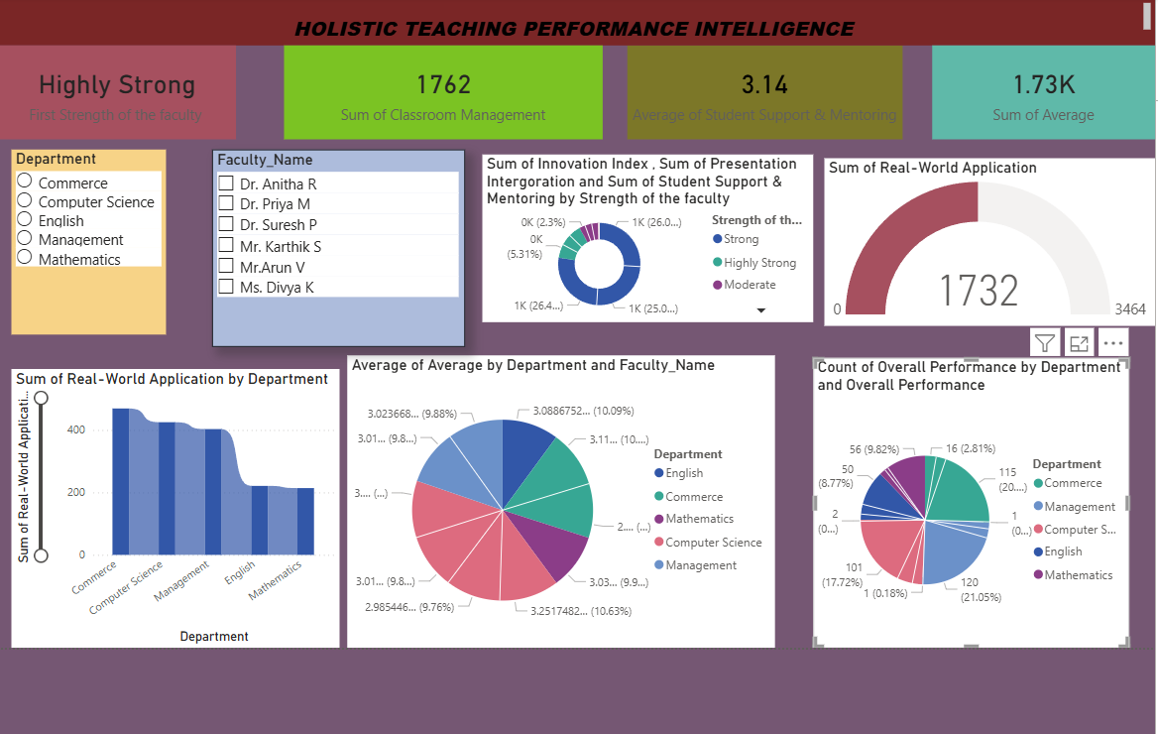
System Architecture
Output / Dashboard

Slide 10
 | Average of Engagement Level of faculty
Department | Dr. Anitha R | Dr. Priya M | Dr. Suresh P | Mr. Karthik S | Mr.Arun V | Ms. Divya K | Grand Total
Commerce | 3.17 |  | 3.00 |  |  |  | 3.09
Computer Science | 3.27 |  | 2.95 | 2.83 |  | 2.84 | 2.90
English |  |  |  |  |  | 3.13 | 3.13
Management |  | 2.93 |  |  | 3.23 |  | 3.04
Mathematics |  |  |  |  | 3.03 |  | 3.03
Grand Total | 3.19 | 2.93 | 2.98 | 2.83 | 3.11 | 3.07 | 3.03
Department-wise Faculty Performance

Slide 11
Video of Project Demo
[https://your-project-demo-link.com]
▶
[Insert your project demo video.
You can embed a video your live project.]

Slide 12

Conclusion
This project successfully demonstrated the application of Artificial Intelligence and Data Analytics in analysing student feedback to evaluate teaching effectiveness. The objectives of identifying faculty performance, analysing department-wise variations, and assessing course satisfaction were effectively achieved through systematic data processing and visualization.
The analysis revealed that overall student satisfaction is high, with the majority of feedback falling under the “Strong” category. Key strengths such as student support and mentoring were identified, while areas like conceptual clarity and engagement were highlighted for improvement. The integration of AI tools further enhanced the ability to extract meaningful insights from qualitative feedback, which is often overlooked in traditional methods.
CONCLUSION

Slide 13
Conclusion
The project adds significant value by transforming raw feedback data into actionable insights, enabling data-driven decision-making for faculty development and academic improvement. It also demonstrates how AI can improve the efficiency, accuracy, and depth of educational analytics.
Overall, the project highlights the importance of leveraging modern tools to enhance teaching quality and student learning experiences, thereby contributing positively to the field of education analytics.
CONCLUSION

Slide 14

The system can also be scaled by integrating data from multiple sources such as Learning Management Systems (LMS), online surveys, and institutional databases, providing a more comprehensive analysis. Developing a web-based or cloud-based dashboard would improve accessibility and allow stakeholders to interact with insights anytime.
Further research can focus on automated recommendation systems, benchmarking faculty performance across institutions, and incorporating student demographic analysis for more personalized insights.
Overall, these enhancements will transform the project into a smart, scalable, and intelligent decision-support system for improving teaching quality and educational outcomes.
Future Scope
Real Time Feedback system
AI & ML Predictive analytics
Sentiment & text Insights

Slide 15
Thank You
AICW Fellowship | Student Project Presentation 2026
LinkedIn | Edunet Foundation

